Slide 1
AgriPredict : Machine Learning-Based Crop Yield Prediction
Himanshu Kumar
Group number
ML-mid sem project

Slide 2
Motivation
Agriculture plays a crucial role in global food security , yet predicting crop yield remains challenging due to com-plex interactions between environmental factors. Traditional methods often rely on historical data and intuition, which may not fully capture modern agriculture’s dynamic nature. Advanced, data-driven approaches are essential for improving crop yield predictions, especially in the face of climate change and resource constraints. This project aims to address this gap by applying machine learning techniques to enhance agricultural productivity and sustainability.

Slide 3
Literature review
1) Crop Yield Prediction Using Machine Learning: A Pragmatic Approach:
This study focuses on improving crop yield prediction in India’s agricultural sector using machine learning techniques such as Random Forest, Adaboost, Gradient Boost, and SVM. It finds that Random Forest achieves the highest accuracy, helping farmers enhance their yields.
Link:(PDF) Crop Yield Prediction Using Machine Learning: A Pragmatic Approach

Slide 4
Literature review
2) Yield Prediction for Crops by Gradient-Based Algorithms :
This study evaluates machine learning algorithms for predicting crop yields, finding that CatBoost, LightGBM, and XGBoost outperform others.
Link: Yield prediction for crops by gradient-based algorithms | PLOS ONE

Slide 5
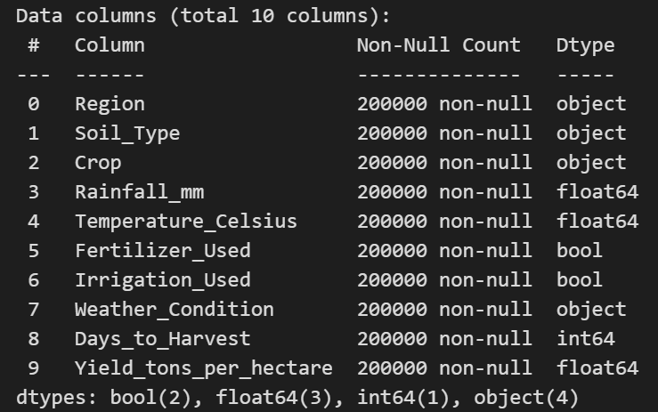
Dataset description

Slide 6
Data description
The dataset being used is related to crop yield prediction and contains multiple features that influence the target variable, which is Yield_tons_per_hectare. This includes information about the region, soil type, crop type, and weather conditions.
We have total 10 attributes(including target variable).
You can see all the attributes in previous image.

Slide 7
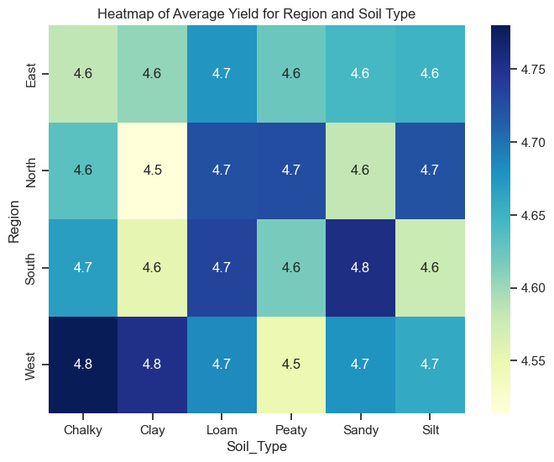

Slide 8
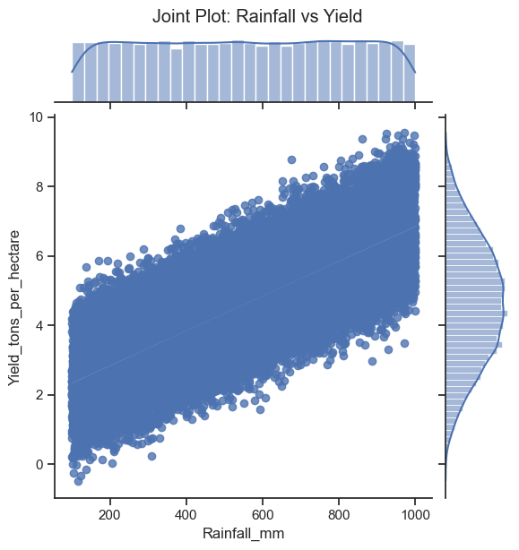
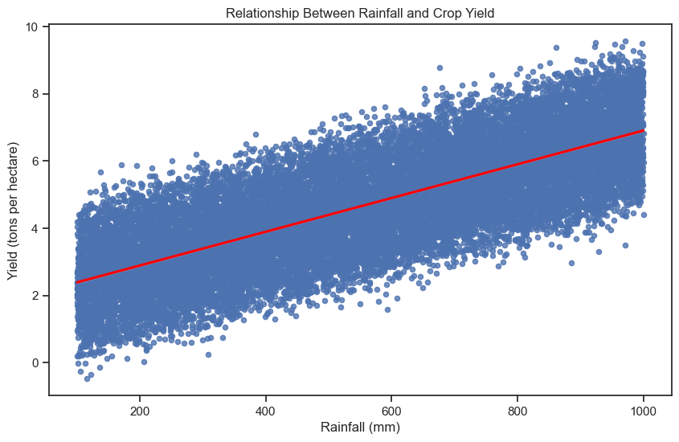

Slide 9
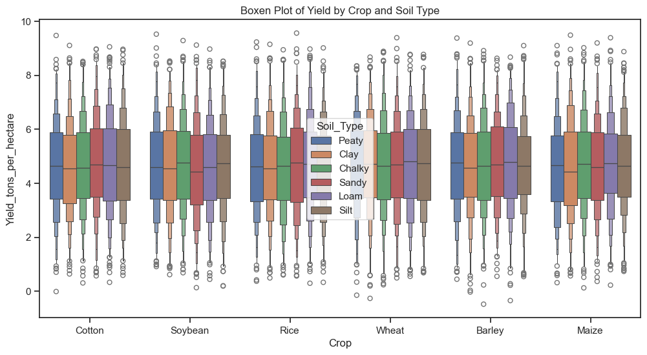

Slide 10
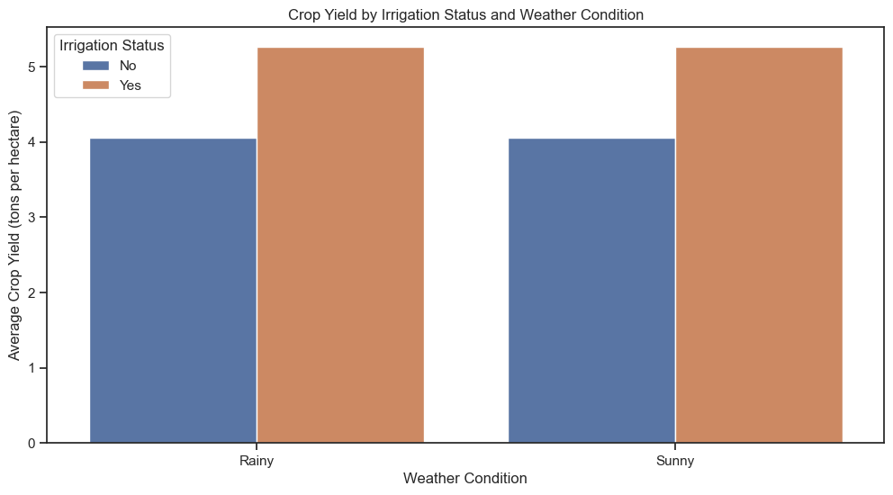

Slide 11
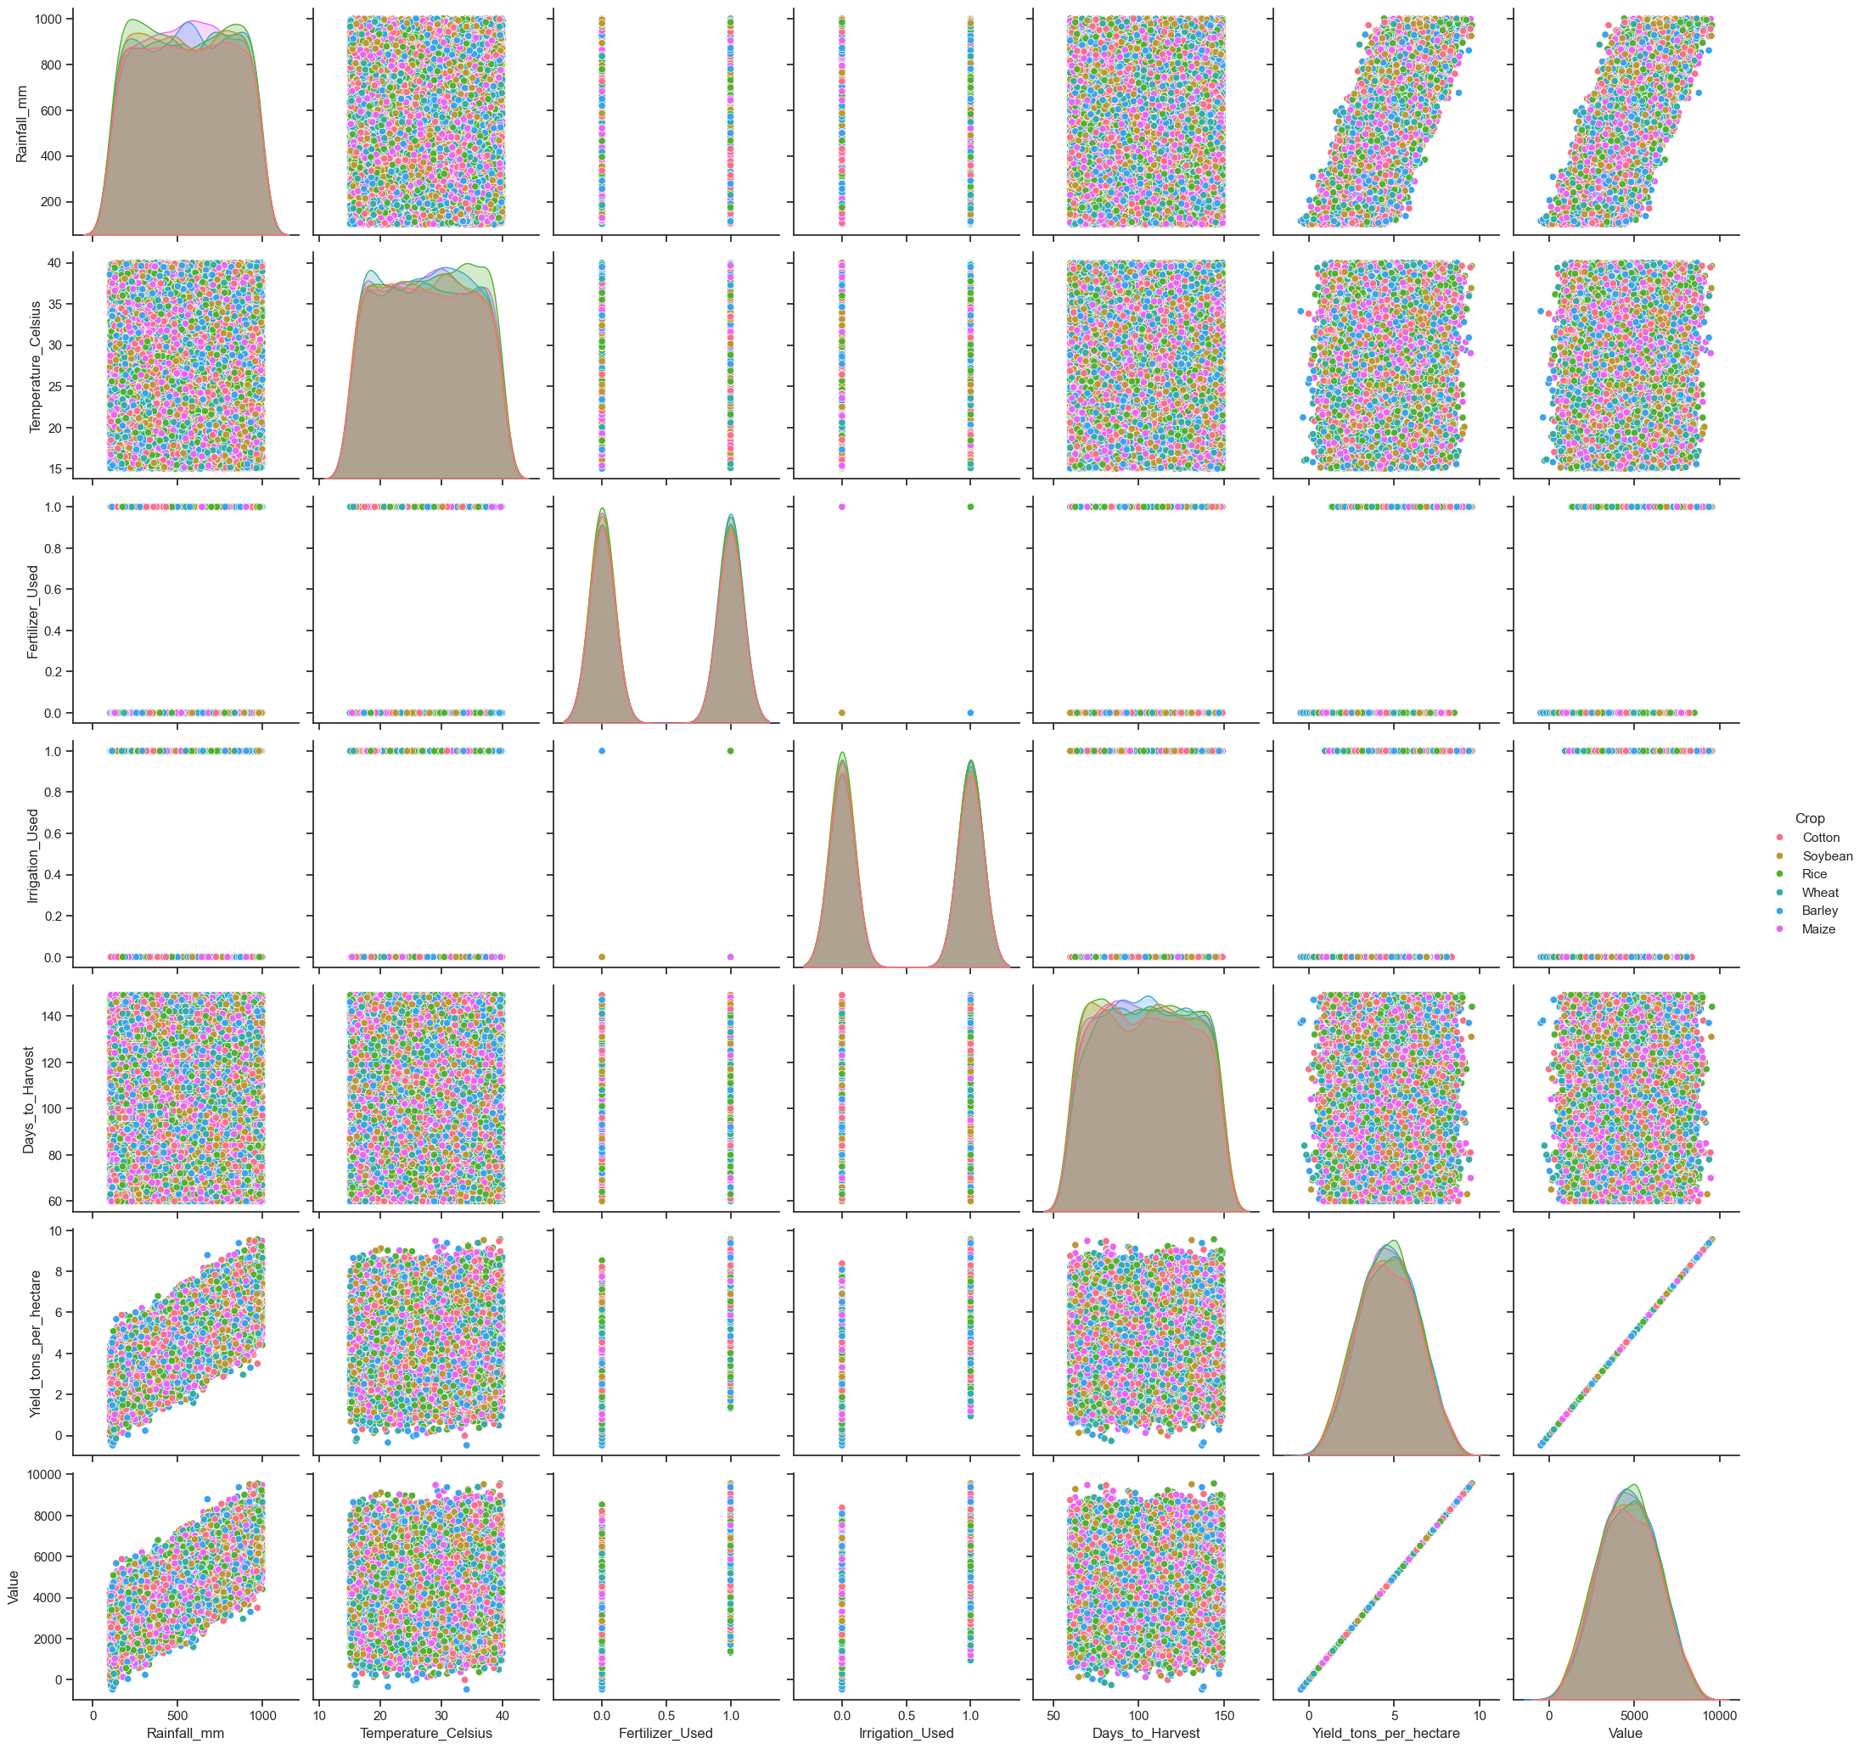

Slide 12
Preprocessing Requirements:
Handling Missing Values: Rows with missing values were dropped to ensure the dataset is clean for training models.
Removing Negative Values(from target variable):Any rows where Yield_tons_per_hectare was negative were removed as such values are not logical in the context of crop yield.
Label Encoding of Categorical Features : Categorical features such as Region, Soil_Type, Crop, and Weather_Condition were encoded into numerical values using Label Encoding.
Data Normalization (Optional):Depending on the model used, features may be scaled

Slide 13
Methodology
Problem definition
Data collection
Data exploration and preprocessing
EDA
Data cleaning
Feature engineering

Slide 14
4) Data splitting
5) Model selection
6) Model training
7) Model evaluation
8) Model optimization
9) Model saving and interface
10) Prediction and visualisation
11)Documentation and reporting

Slide 15
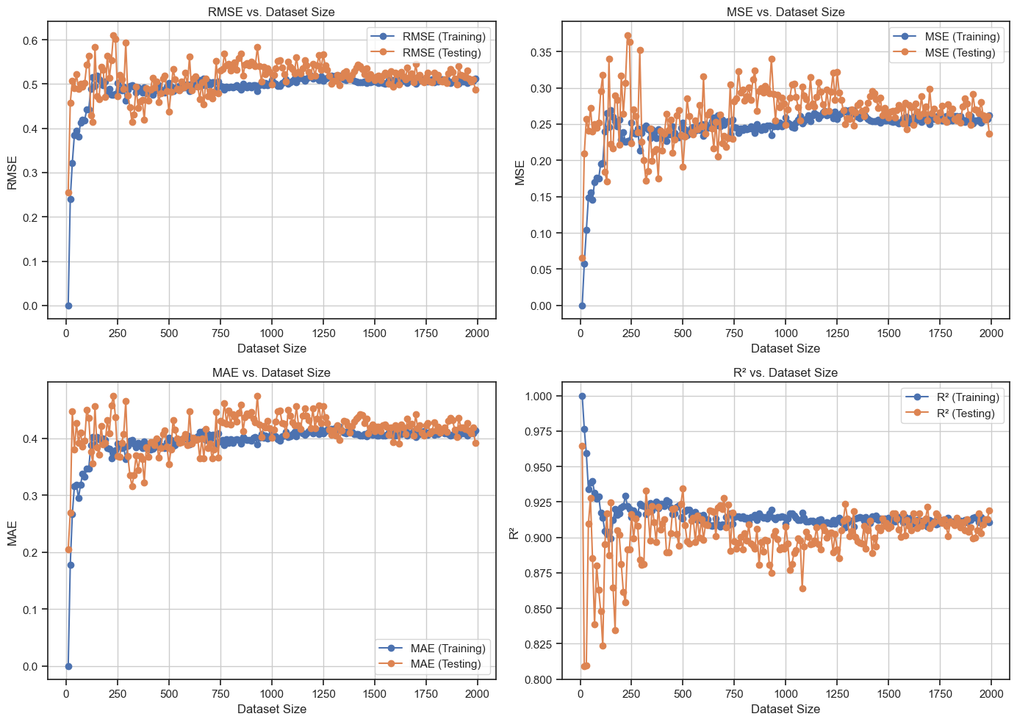
Results/Analysis/conclusion

Slide 16
Timeline
Yes we able to follow time
Week 1 : search suitable dataset , set environment , make git repo.
Week 2 : eda , data cleaning , feature engineering
Week 3 : Model selection
Week4 : Model training and implementation
Week 5: Model evaluation
Week 6: model saving

Slide 17
Individual team members’ contributions
Himanshu Kumar : data collection ,model implementation and evaluation, eda, mse graph , model saving
Naman: data collection , eda, model implementation and evaluation ,feature engineering ,
Nishchay: eda , data cleaning, model training, feature engineering, help in model implementation
Harshil: eda ,feature engineering , data cleaning, model training , help in model implementation

Slide 18
Thank You

